Slide 1

RADIANT HOSPITAL PRESENTATION
Created by: Shaina Pereira

Slide 2

INTRODUCTION
The Radiant Hospital Management project is a comprehensive SQL-based solution designed to streamline and optimize hospital operations. It manages key aspects such as patient records, doctor schedules, room allocations, appointments, admissions, surgeries, and prescriptions efficiently. By leveraging relational database concepts, the system ensures data integrity, reduces redundancy, and facilitates real-time access to critical information.
This project aims to enhance decision-making, improve patient care, and support hospital administration by providing structured, reliable, and scalable database solutions tailored for healthcare environments.

Slide 3

QUESTIONS
Write a Query in SQL to find all the information of the nurses who are yet to be registered .
Write a query in SQL to obtain the name of the physicians who are the head of each department.
Write a query in SQL to count the number of patients who taken appointment with at least one physician.
Write a query in SQL to count the number unavailable rooms
Write a query in SQL to obtain the name of the physicians who are trained for a special treatement.
Write a query in SQL to obtain the name of the physicians with department who are yet to be affiliated.
Write a query in SQL to obtain the name of the physicians who are not a specialized physician.
Write a query in SQL to find the name of the patients, their treating physicians and medication

Slide 4

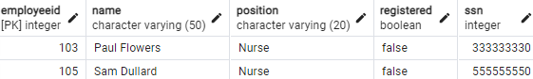
select * from nurse where registered = 'false';
WRITE A QUERY IN SQL TO FIND ALL THE INFORMATION OF THE NURSES WHO ARE YET TO BE REGISTERED.
Output:-

Slide 5
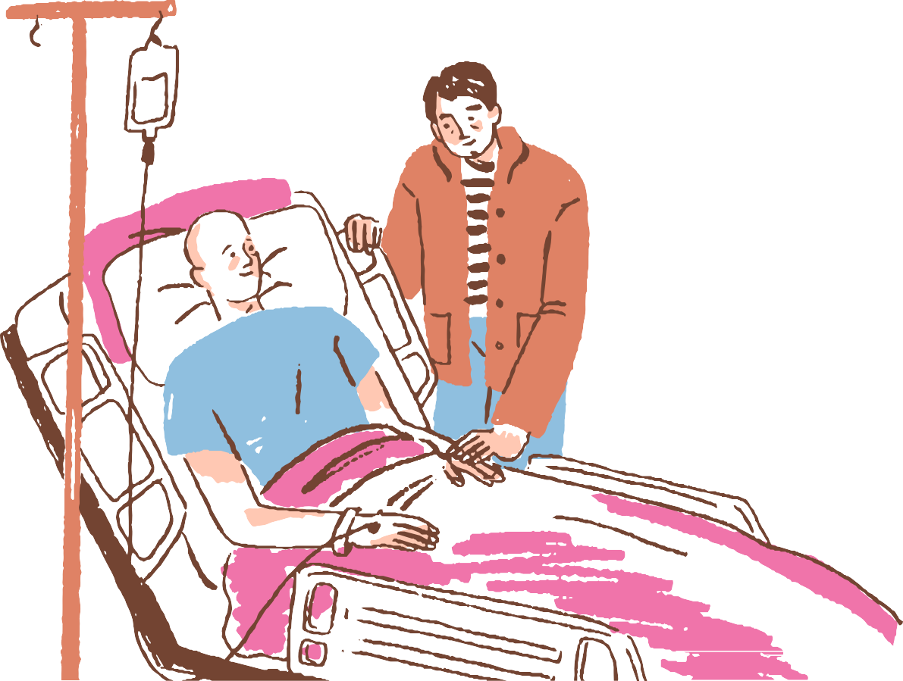
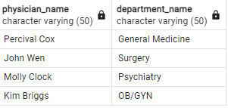
select p.name as physician_name , d.name as department_name from physician p
WRITE A QUERY IN SQL TO OBTAIN THE NAME OF THE PHYSICIANS WHO ARE THE HEAD OF EACH DEPARTMENT.
inner join department d on p.employeeid=d.head;
Output:-

Slide 6

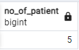
select count (distinct (patient)) as no_of_patient from appointment;
WRITE A QUERY IN SQL TO COUNT THE NUMBER OF PATIENTS WHO TAKEN APPOINTMENT WITH AT LEAST ONE PHYSICIAN.
Output:-

Slide 7
WRITE A QUERY IN SQL TO COUNT THE NUMBER UNAVAILABLE ROOMS
select count(roomnumber) as no_of_rooms from room
where unavailable ='false';
Output:-

Slide 8

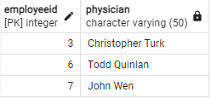
select employeeid , name as physician from physician
WRITE A QUERY IN SQL TO OBTAIN THE NAME OF THE PHYSICIANS WHO ARE TRAINED FOR A SPECIAL TREATEMENT.
where employeeid in (select distinct physician from trained_in);
Output:-

Slide 9

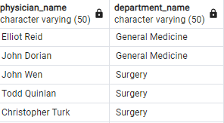
WRITE A QUERY IN SQL TO OBTAIN THE NAME OF THE PHYSICIANS WITH DEPARTMENT WHO ARE YET TO BE AFFILIATED.
select p.name as physician_name ,d.name as department_name from physician p
inner join affiliated_with aw
on p.employeeid = aw.physician inner join department d
on aw.department = d.department_id where primaryaffiliation='t';
Output:-

Slide 10

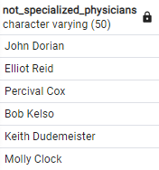
WRITE A QUERY IN SQL TO OBTAIN THE NAME OF THE PHYSICIANS WHO ARE NOT A SPECIALIZED PHYSICIAN.
select name as not_specialized_physicians from physician where employeeid not in(select distinct physician from trained_in);
Output:-

Slide 11
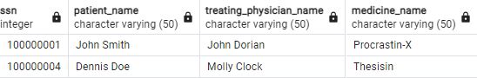
WRITE A QUERY IN SQL TO FIND THE NAME OF THE PATIENTS, THEIR TREATING PHYSICIANS AND MEDICATION
select distinct p.ssn,p.name as patient_name,ph.name as treating_physician_name,m.name as medicine_name from patient p
inner join undergoes u on p.ssn = u.patient inner join prescribes pr on u.patient = pr.patient inner join medication m
on pr.medication = m.code inner join physician ph
on pr.physician = ph.employeeid;
Output:-

Slide 12
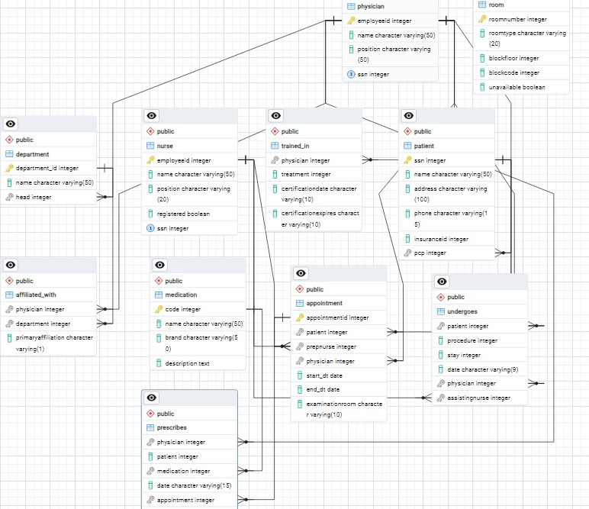
ERD DIAGRAM

Slide 13

CONCLUSION
The Radiant Hospital Management project demonstrates the power and efficiency of SQL in managing complex healthcare operations. By streamlining processes like patient records, doctor schedules, room allocations, and more, the system ensures improved organization and better decision- making. This project not only highlights the importance of structured data management but also serves as a scalable foundation for enhancing hospital services, ultimately contributing to better patient care and operational excellence.

Slide 14


